Slide 1
Codestellations
BlazeClan
Team Hackeneurs

Slide 2
AIM
To create a platform that eases the process of learning for students across various fields and boards with the help of chatbots, videos, etc.

Slide 3
Functionalities of AWS Used
Amazon Lex
AWS Rekognition
Alexa Skill (Built)
EC2( WebServer in Public Domain)
VPC(Public Subnet: Website) (Private Subnet: Database)
RDS(Lauched T2.micro server for RDS Service)(Database: MySQL)
Security Group(Restricted to Base class network)

Slide 4
Tools Used
TensorFlow
Django
Image Processing
Natural Language Processing

Slide 5
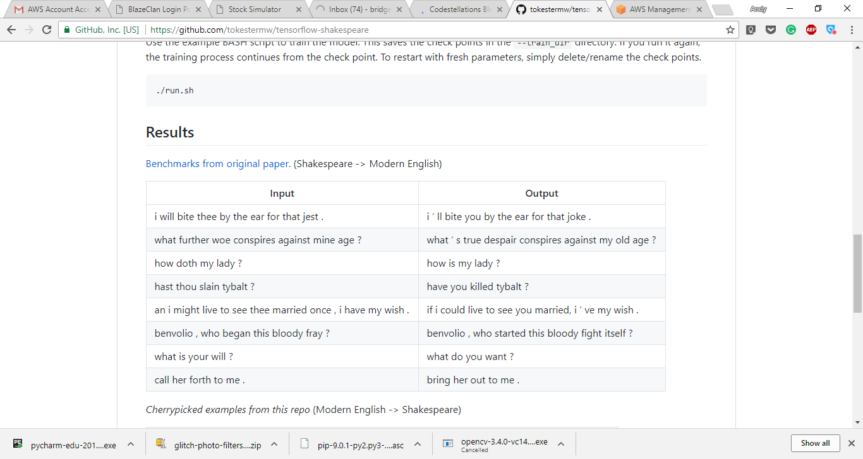
Functions
Chat bot that behaves as a historical figure and chats with the student
A Tensorflow(Recurrent Neural Networks) model that implements conversion of Shakespeare to normal English and vice versa
Video to Text Conversion using AWS Services

Slide 6
